Slide 1


The Lattice Boltzmann Method to Simulate Fluid Flow Around Renewable Devices
By Andrew Cunningham, Jian Zhou and Jon Shiach
Centre for mathematical modelling and flow analysis, Department of Computing and Mathematics, Manchester Metropolitan University, Manchester, M1 5GD

Slide 2
Aims and Objectives
Objectives
To accurately model the lid-driven cavity problem using the lattice Boltzmann method using Matlab.
To add objects within the cavity to see how the flow adapts.
To extend the cavity to a shallow cavity model.
To use this towards real world examples such as harbors.

Slide 3
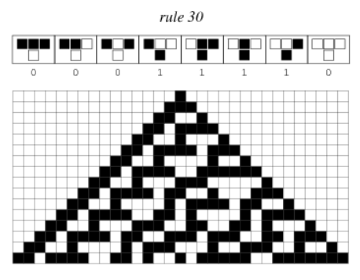
Introduction
The lattice Boltzmann method is a successor to the lattice gas automata.
Fig 1 Cellular automata example (Weisstein, 2018)

Slide 4
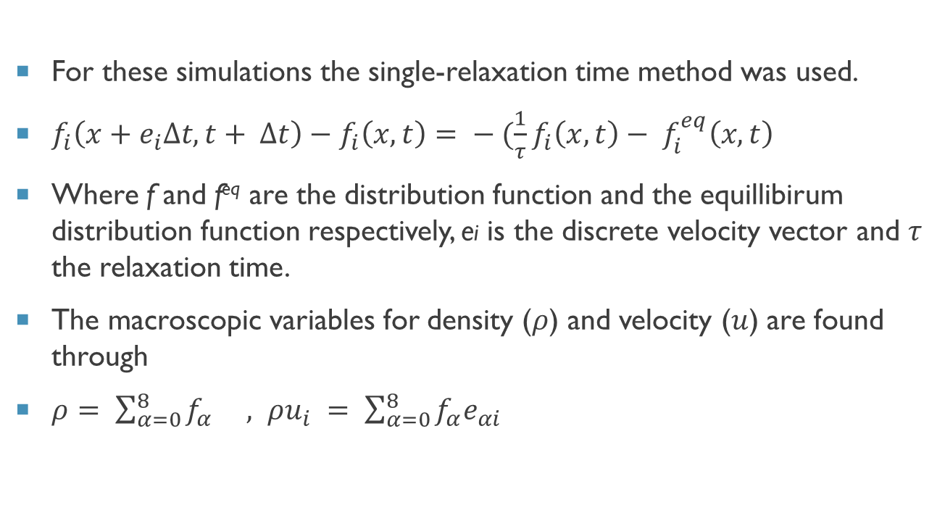
Lattice Boltzmann method (LBM)
For these simulations the single-relaxation time method was used.
$f_{i}\left(x+e_{i}∆t, t+ ∆t\right)−f_{i}\left(x, t\right)= − (\frac{1}{τ}f_{i}\left(x, t\right)− f_{i}^{eq}\left(x, t\right)$
Where f and f^{eq} are the distribution function and the equillibirum distribution function respectively, ei is the discrete velocity vector and $τ$ the relaxation time.
The macroscopic variables for density ($ρ$) and velocity ($u$) are found through
$ρ= \sum_{α=0}^{8}{f_{α} , ρu_{i} = \sum_{α=0}^{8}{f_{α}e_{αi} }}$
6
2
5
3
0
1
7
4
8
Fig 2 A D2Q9 lattice configuration

Slide 5
Chapman-Enskog Expansion
The Chapman-Enskog expansion provides the framework in which equations for hydrodynamics for a gas can be derived using the Boltzmann equation. Therefore allowing the passage from the microscopic description to a hydrodynamical one.
The Boltzmann equation for a 1-particle distribution function f(r,v,t)

Slide 6
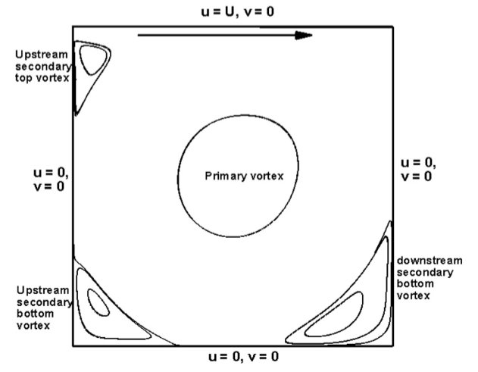
Lid-Driven cavity problem
U = u, V = 0
Upstream Secondary Vortex
U = 0
V = 0
Primary Vortex
U = 0
V = 0
Upstream Secondary Bottom Vortex
Downstream Secondary Bottom Vortex
U = 0, V = 0
Fig 1 Lid Driven Cavity (Perumal and Dass, 2013)

Slide 7
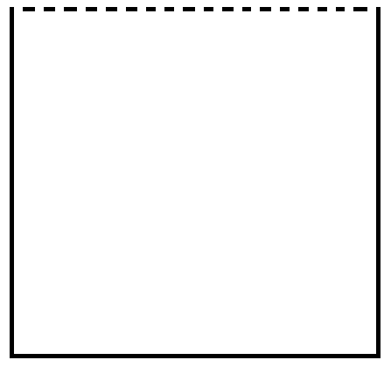
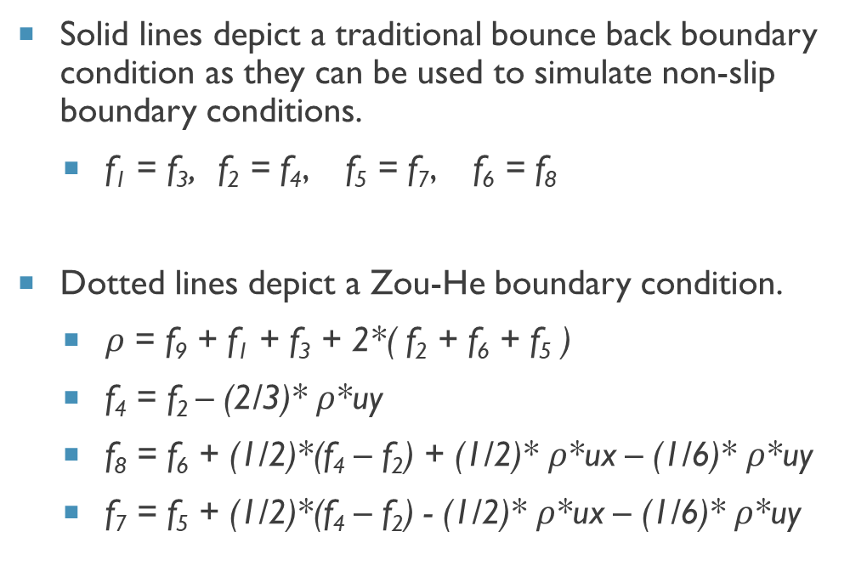
Boundary Conditions
U
Solid lines depict a traditional bounce back boundary condition as they can be used to simulate non-slip boundary conditions.
f₁ = f₃, f₂ = f₄, f₅ = f₇, f₆ = f₈
Dotted lines depict a Zou-He boundary condition.
$ρ$ = f₉ + f₁ + f₃ + 2*( f₂ + f₆ + f₅ )
f₄ = f₂ – (2/3)* $ρ$*uy
f₈ = f₆ + (1/2)*(f₄ – f₂) + (1/2)* $ρ$*ux – (1/6)* $ρ$*uy
f₇ = f₅ + (1/2)*(f₄ – f₂) - (1/2)* $ρ$*ux – (1/6)* $ρ$*uy
Y
X

Slide 8
Benchmark of the lid-driven cavity using (Ghia1982)

Slide 9
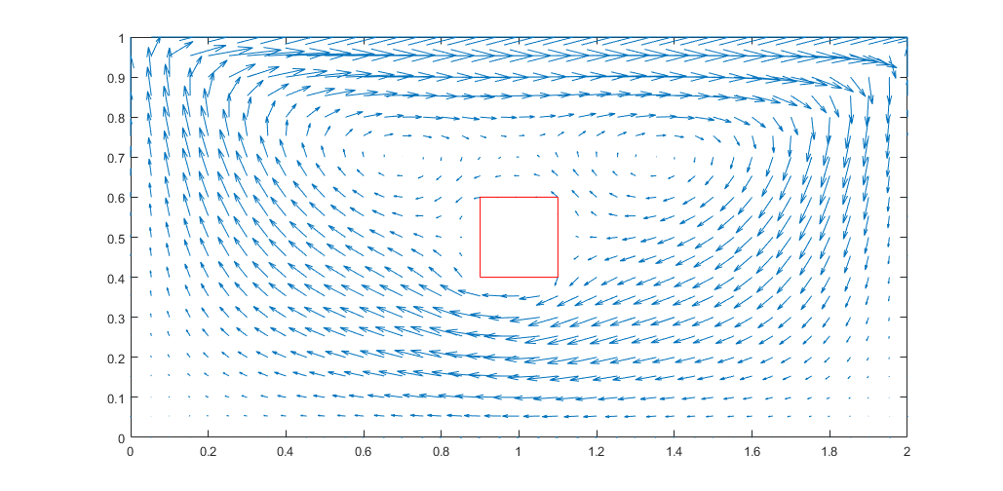
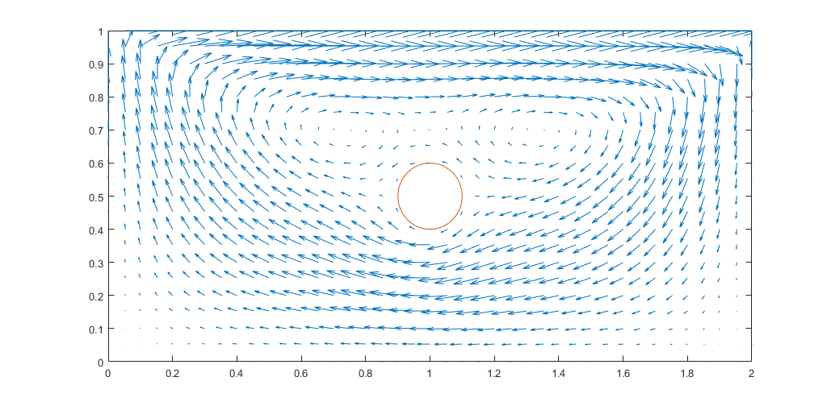

Extending the cavity to 2x1 after 50000 iterations

Slide 10
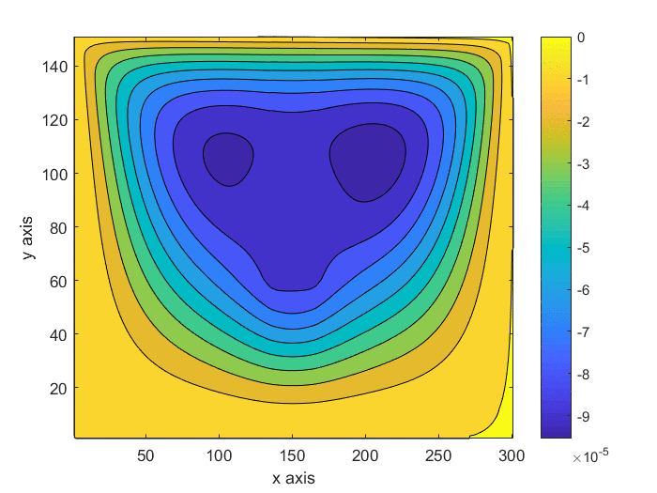
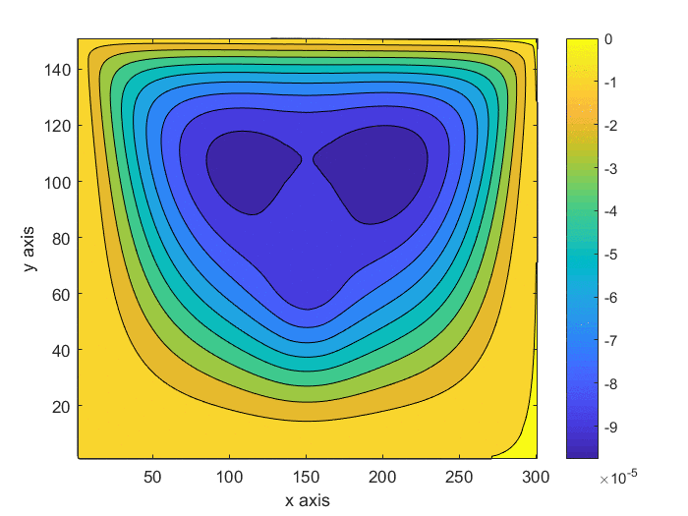
Extending the cavity to 2x1 after 50000 iterations
Cuboid Contour Plot
Cylinder Contour Plot

Slide 11
Velocity changes for the extended cavity

Slide 12
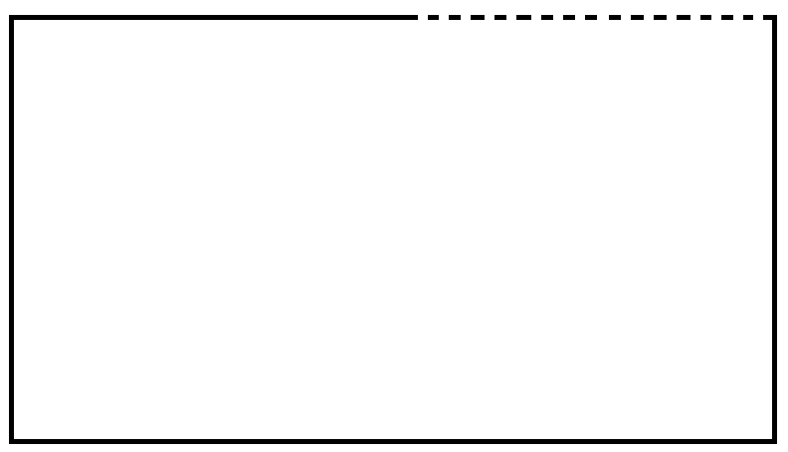
Harbors
The lid-driven cavity model can be adapted to model harbors where the initial u velocity will be produced by the larger body of fluid.
For simplicity only a 2:1 ratio was applied to the x and y axis respectively.
Halfway along the top of the cavity the horizontal force of the lid is applied.
U
Y
X

Slide 13
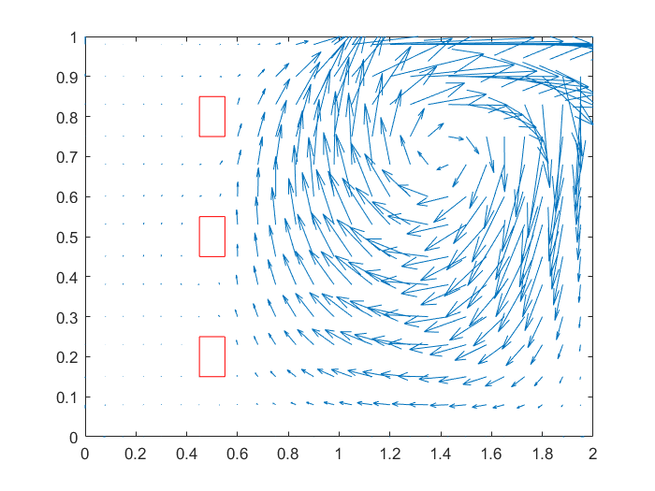
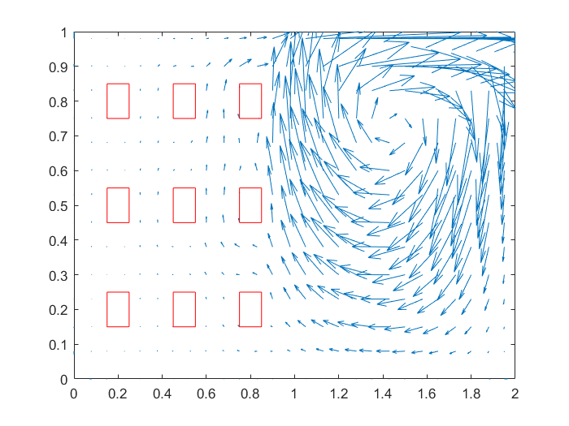
Harbor Velocity Vector after 50000 iterations

Slide 14
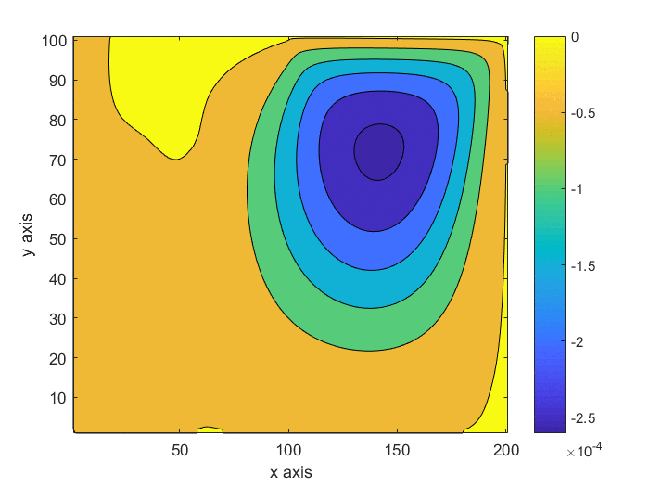
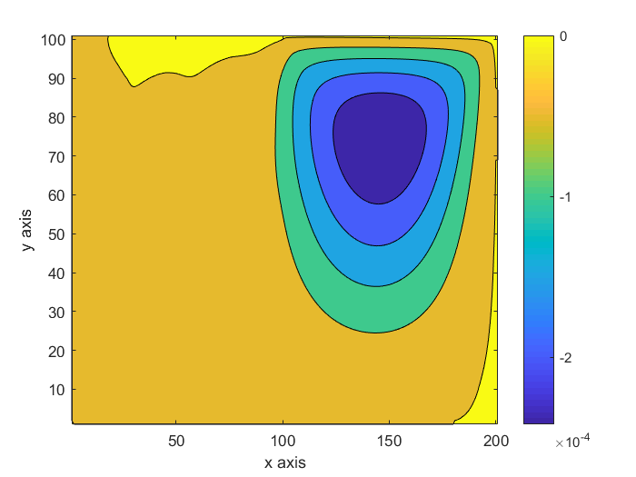
Harbor Velocity Vector after 50000 iterations
3 Vessels Contour Plot
9 Vessels Contour Plot

Slide 15
Horizontal Velocity around the ships at x = 0.5

Slide 16
Vertical Velocity around the ships at y = 0.5

Slide 17
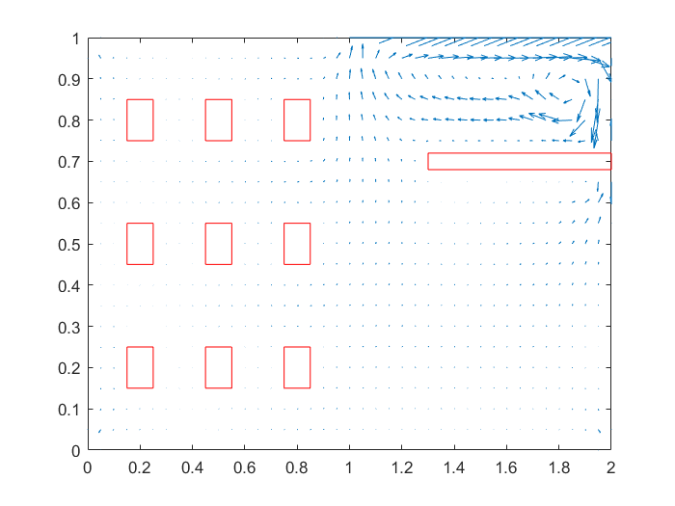
Adding Breakwater
Constants
Re 5000
9 Vessels
2 x 1 shallow cavity

Slide 18
Breakwater Velocity Graphs

Slide 19
Future Work
U
To continue the model for harbors and develop a multiphase simulation for the surface water.
To adapt the model to a whirlpool turbine generator seen in Fig 3.
Y
X
Fig 3 Whirlpool turbine hypothetical

Slide 20
Conclusion
The shape of the object does not seem to effect the flow significantly as long as they are of similar sizes.
The further the objects from the inlet the more the velocity surrounding the objects decreases.
Breakwaters had a significant impact upon the velocity of the fluid surrounding the objects no matter what size they are.

Slide 21
References
Ghia, U, K N Ghia, and C T Shin (1982). High-Resolutions for Incompressible Flow Using the Navier-Stokes Equations and a Multigrid Method. Tech. rep., pp. 387–411.
Perumal, D. Arumuga and Anoop K. Dass (2013). “Application of lattice Boltzmann method for incompressible viscous flows”. In: Applied Mathematical Modelling 37.6, pp. 4075–4092
Zou, Qisu and Xiaoyi He (1997). “On pressure and velocity flow boundary conditions and bounce-back for the lattice Boltzmann BGK model”. In: Physics of Fluids 9.6, pp. 1591–1598.

Slide 22
Thank You Any Questions?

Slide 23
Horizontal Velocity at the primary vortex, x = 1.5

Slide 24
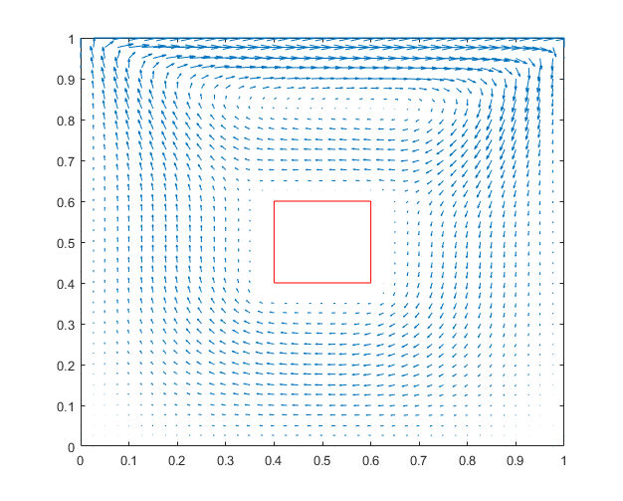
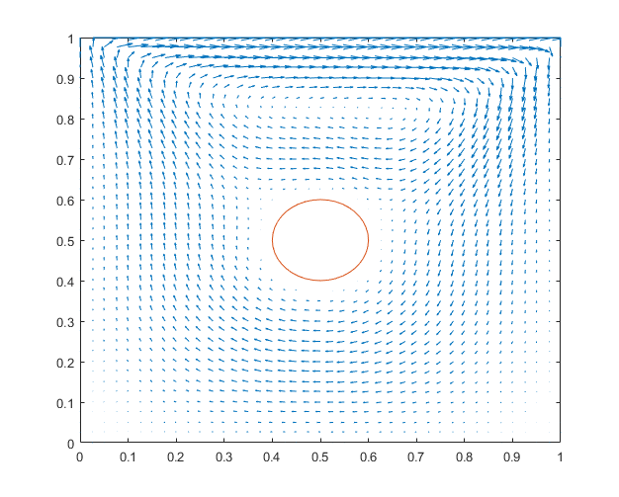
Objects within the Cavity after 50000 iterations

Slide 25
Horizontal velocity at the midpoint of x

Slide 26
Vertical Velocity at the midpoint of y

